Slide 1
Alpha-Numeric Codes
1. American Standard Code for Information Interchange (ASCII) Character Code

Slide 2
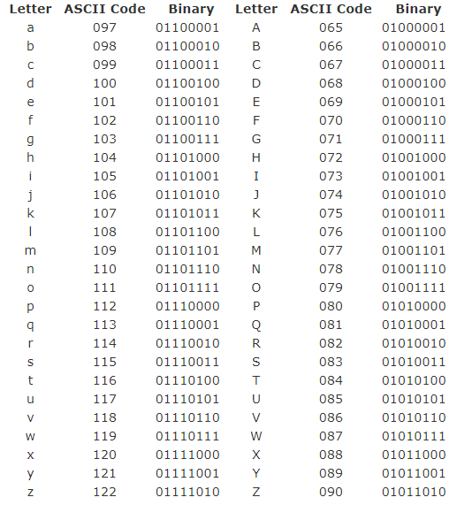
ASCII

Slide 3
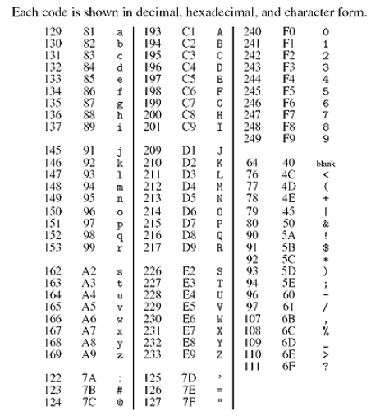
Alpha-Numeric Codes
2. Extended Binary Coded Decimal Interchange Code(EBCDIC)
It uses 8-bits to represent.
It does not use a linear ordering
of letters.
It has a maximum of 256 characters.

Slide 4
ASCII Character Codes
American Standard Code for Information Interchange.
A popular code used to represent information sent as character- based data.
It uses 7-bits to represent.
ASCII uses a linear ordering of letters.
ASCII has a maximum of 128 characters.

Slide 5
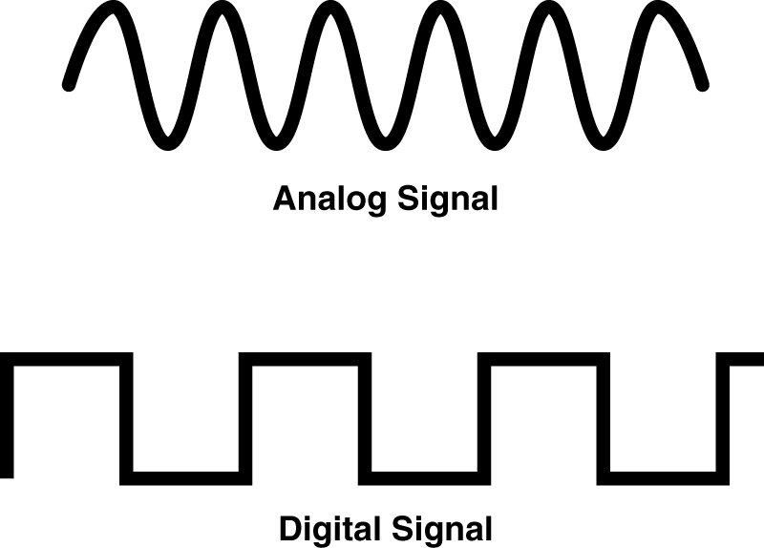
Analog and Digital Signal
 Analog system
◆ The physical quantities or range.
 Digital system
◆ The physical quantities or
signals may vary continuously over a specified
signals can assume only discrete values.

